Slide 1
INTRODUCTION TO FLUTTER AND DART PROGRAMMING LANGUAGE
LESSON 1
LESSON
01
TMA3084 - Software Engineering Laboratory
Lab Demo: Mr. Raynold Anak Kabai
Lecturer: Madam Nurfauza Binti Jali

Slide 2
TABLE OF CONTENTS
1
Introduction
5
Installing Dart SDK
Dart to VSC / VSC to Dart
2
Importance of Flutter
6
Lab 1: Installing Dart IDE and writing Dart program
3
Introduction to Dart
7
GitHub & CI/CD (Part 1)
4
Introduction to DartPad

Slide 3







INTRODUCTION TO FLUTTER
What is Flutter?
Flutter's Popularity?
Flutter is an open-source UI toolkit created by Google.
It allows cross-platform app development using a single codebase.
Apps are compiled natively for Android, iOS, web, desktop, etc.
Flutter is used by companies around the world including Alibaba, Capital One, and Groupon for apps that touch hundreds of millions of users.
Course Purpose?
The purpose of this course is to enable developers to create high-performance and attractive apps that feel natural on iOS & Android devices.

Slide 4
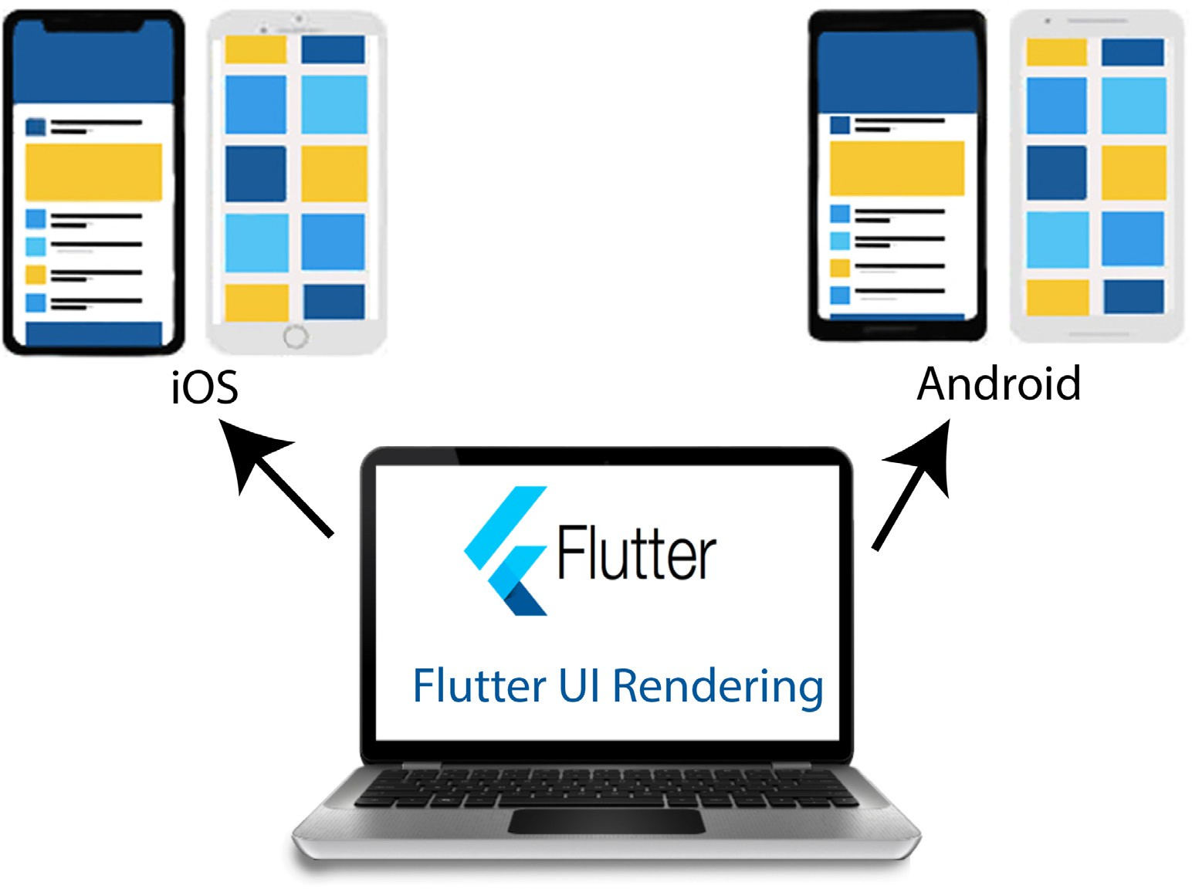
IMPORTANCE OF FLUTTER
With Flutter, anyone can build native iOS and Android apps using a single codebase. No need to learn Swift, Objective-C, Java, or Kotlin. Just use Dart and you're ready to create high-performance apps for both platforms.
1
Cross-Platform Development
2
Fast Development Cycle
3
Customizable & Beautiful UI
Build apps for Android, iOS, Web, and Desktop, all from one codebase.
Saves time and effort compared to maintaining separate apps for each platform.
Hot Reload lets developers see code changes instantly.
Boosts productivity and encourages experimentation during lab work and real-world projects.
Flutter comes with a wide range of pre-built widgets.
Enables creation of visually attractive and modern UIs easily.

Slide 5

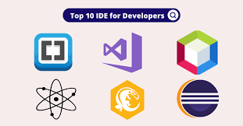


INTRODUCTION TO DART
Dart is an open-source, general-purpose programming language developed by Google. It is the primary language used to build Flutter apps.
Writing a Dart Program?
IDE
Dart SDK
A graphical user interface software which helps you write, save, edit, and run the Dart code.
A software to translate these Dart commands, which are written in a Dart IDE (such as Android Studio), to a lower level language to create an executable program.

Slide 6
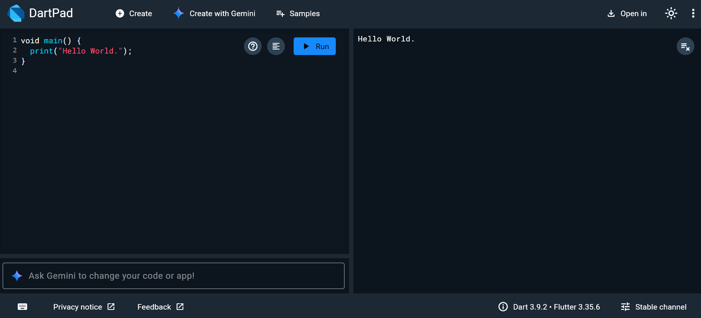

INTRODUCTION TO DARTPAD
What is DartPad?
DartPad is an open-source tool that lets you work with the Dart language in any modern web browser. It is a great, no-download-required way to learn Dart syntax and to experiment with Dart language features.
How to Use DartPad?
Type:
https://dartpad.dev

Slide 7

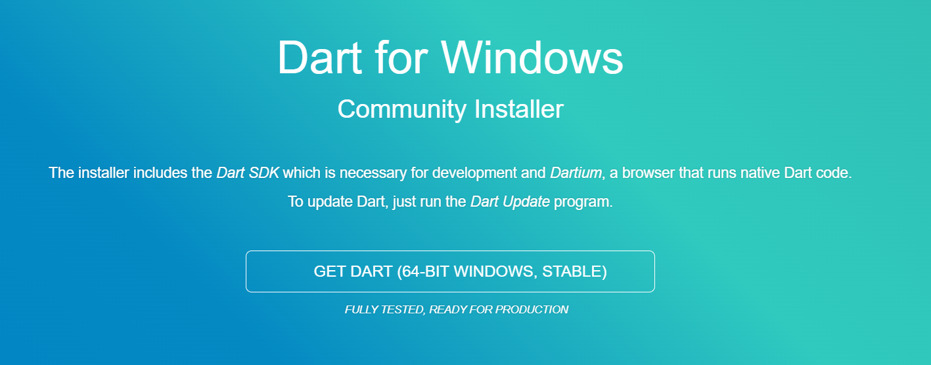

INSTALLING DART SDK
Install from official website
Go to: https://dart.dev, then click the “Get Dart” tab, or go directly to https://dart.dev/get-dart
Step 1: for Windows users
1
Click https://gekorm.com/dart-windows
2
Click The Get Dart Stable Version
Video Tutorial: Click Video Tutorial

Slide 8
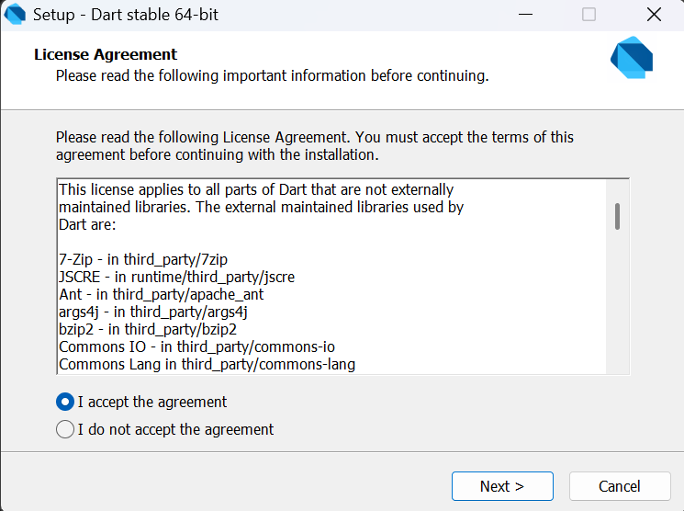

INSTALLING DART SDK
Accept the agreement

Slide 9
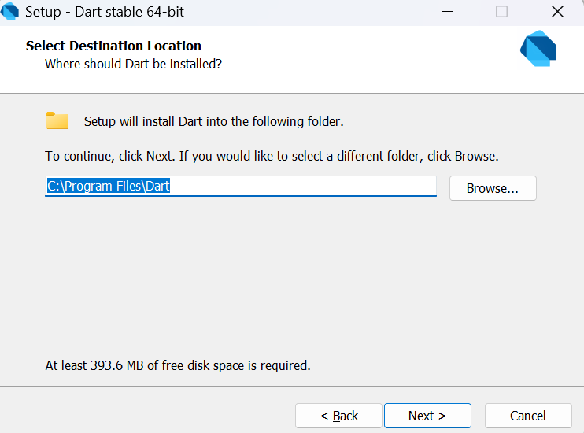
INSTALLING DART SDK
Check the folder location

Slide 10
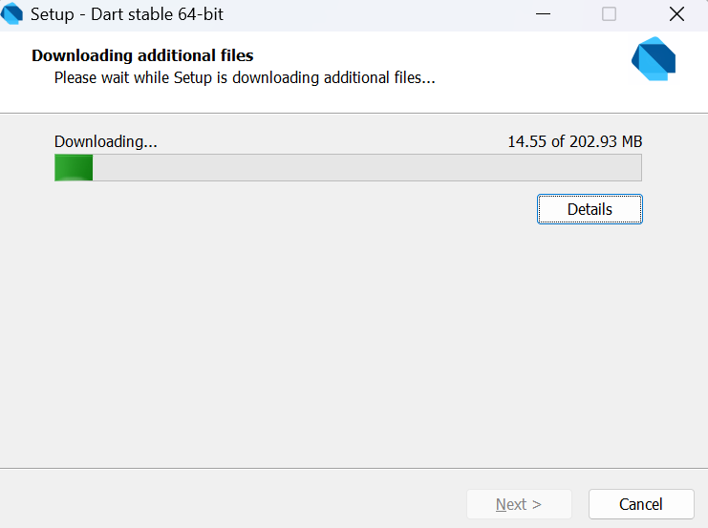
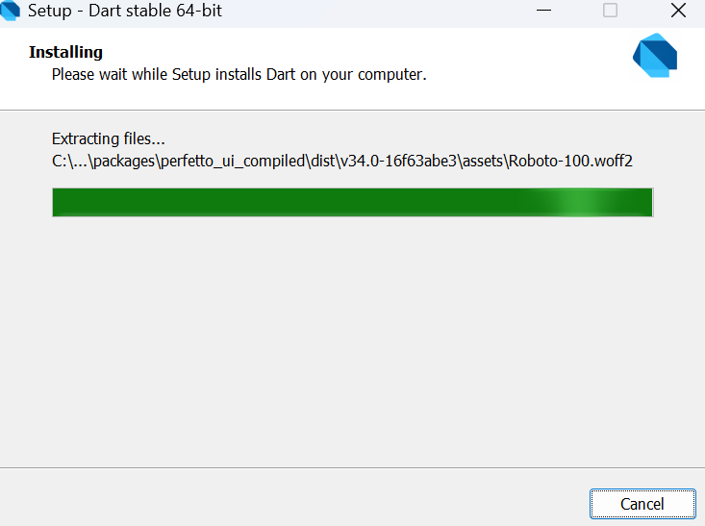
INSTALLING DART SDK
Download the files and install

Slide 11
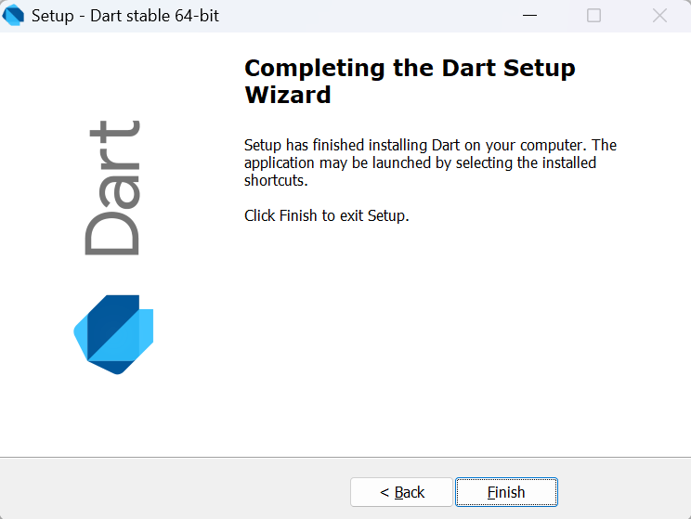
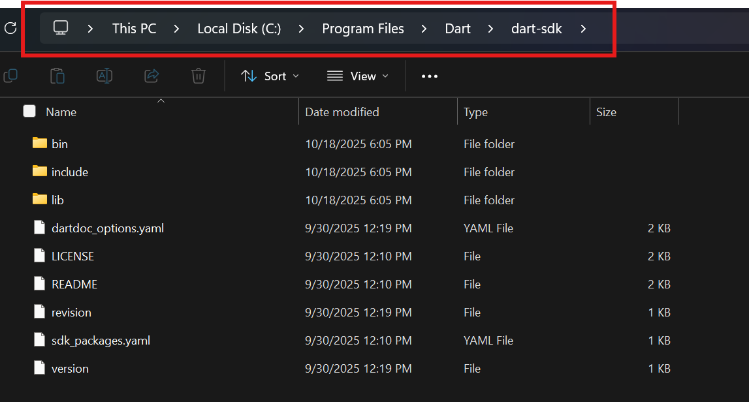
INSTALLING DART SDK
Installation is completed and we can check the dart sdk is alive in our computer

Slide 12

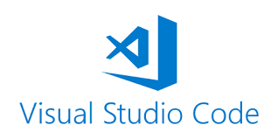
INSTALLING VS CODE
What is VS Code?
Visual Studio Code is a versatile code editor for software development, supporting multiple programming languages and frameworks. It is developed by Microsoft and offers extensive customization through extensions.
Downloading VS Code?
Go to:
https://code.visualstudio.com/download

Slide 13
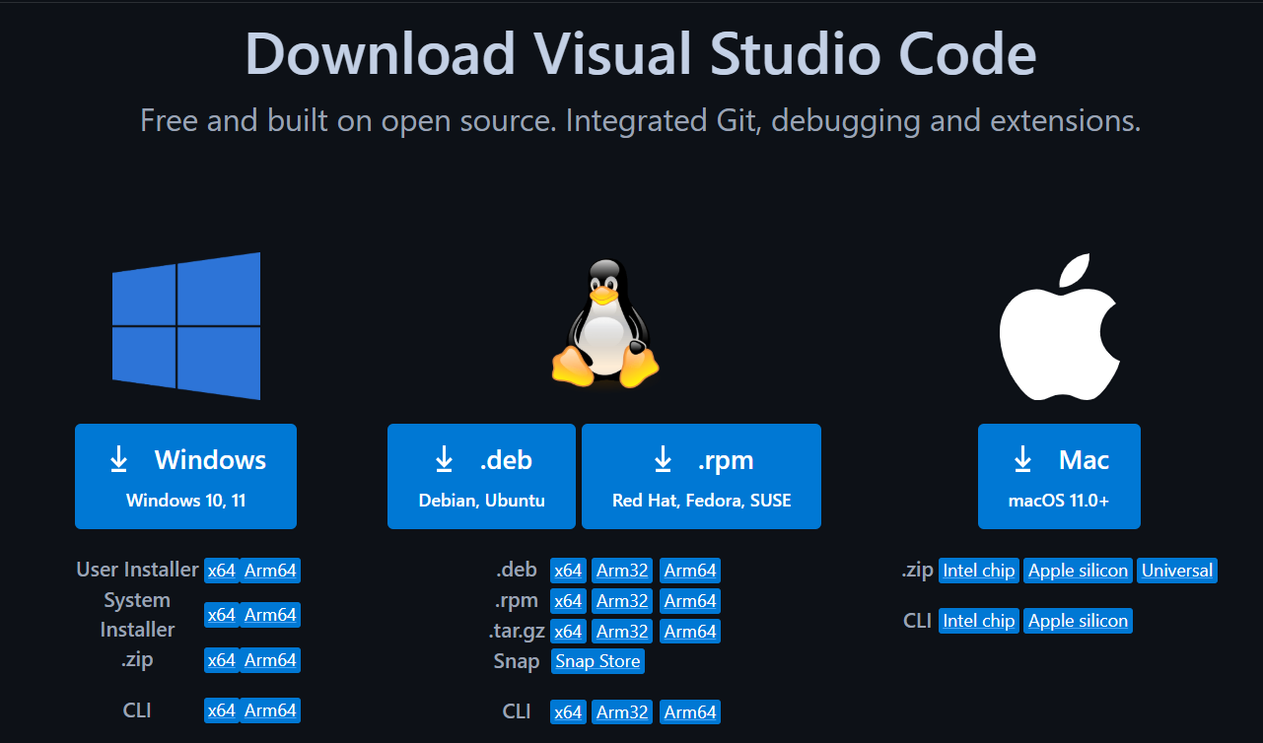
INSTALLING VS CODE
Choose the app based on your OS

Slide 14
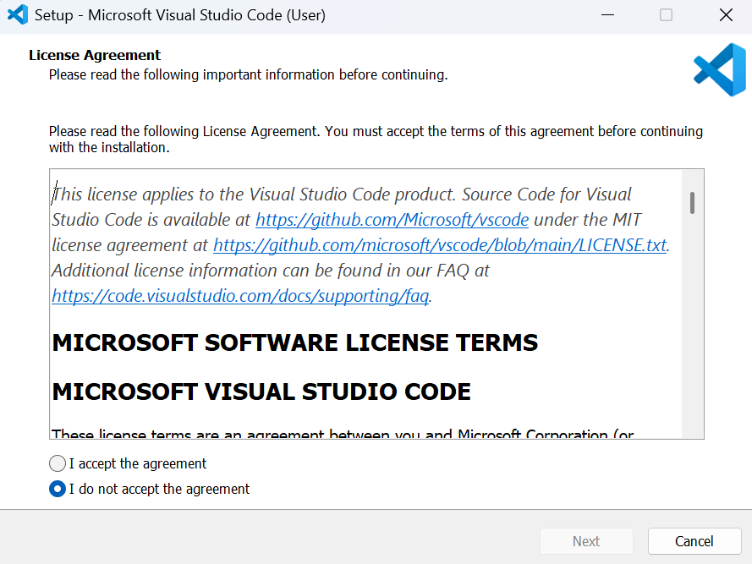
INSTALLING VS CODE
Accept the agreement

Slide 15
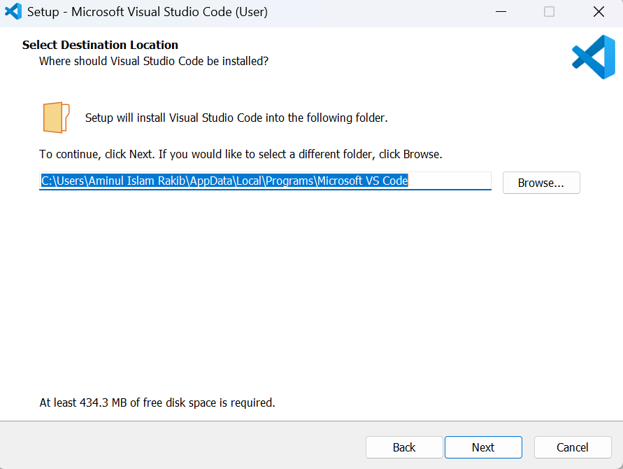
INSTALLING VS CODE
Check your folder location

Slide 16
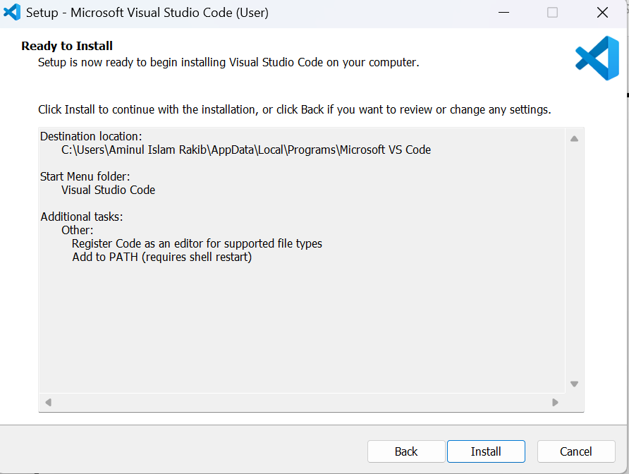
INSTALLING VS CODE
Install all documents

Slide 17
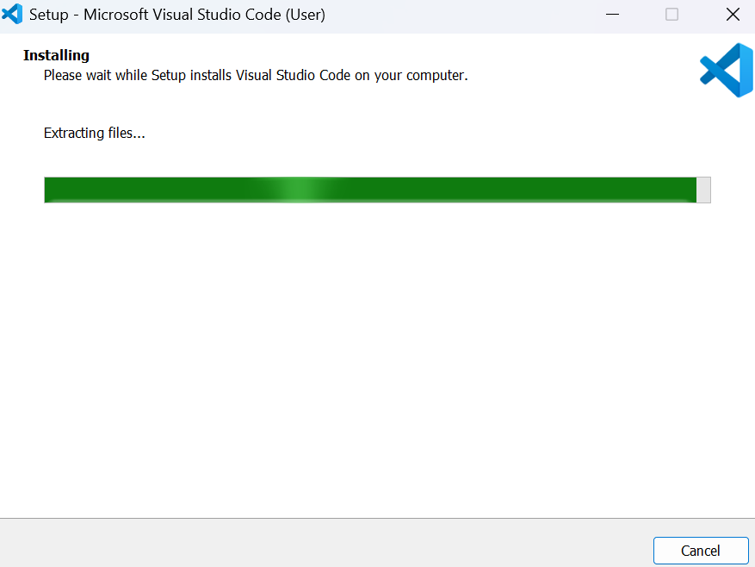
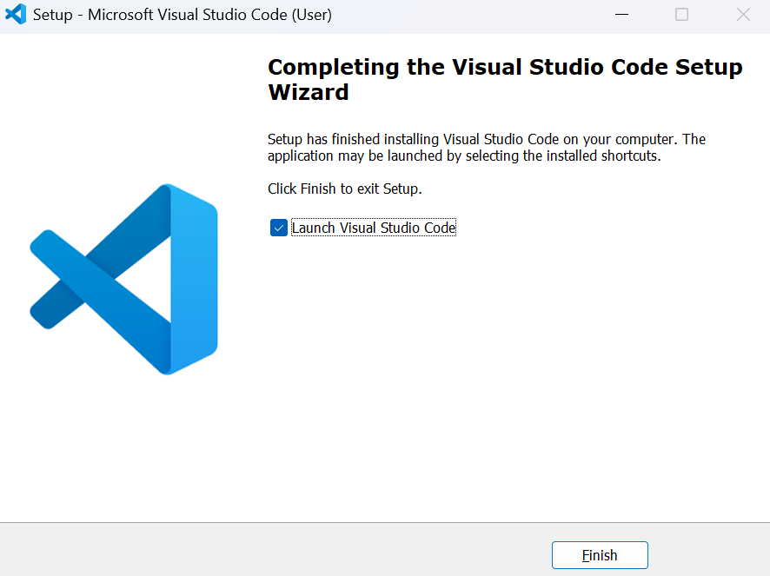
INSTALLING VS CODE
Wait for the installation to complete

Slide 18
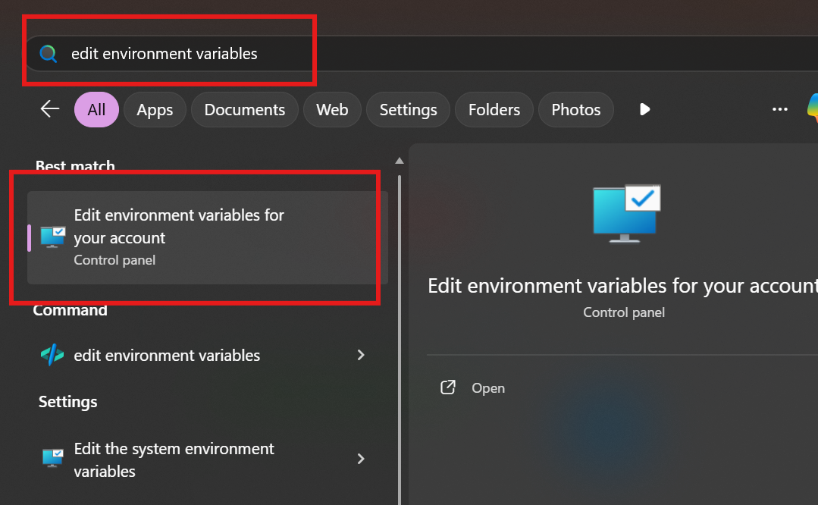
INSTALLATION DART TO VSC
In the Windows search bar, type edit environment variable

Slide 19
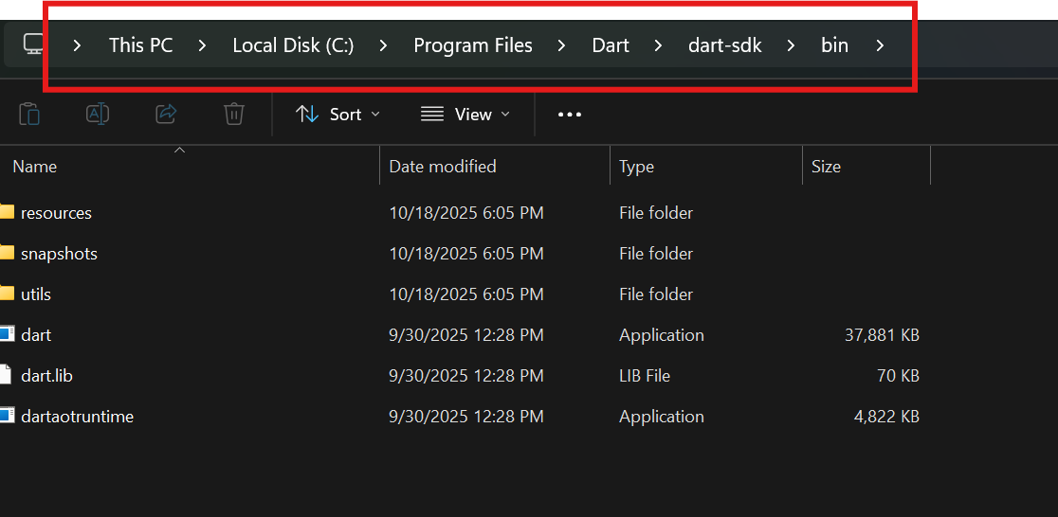
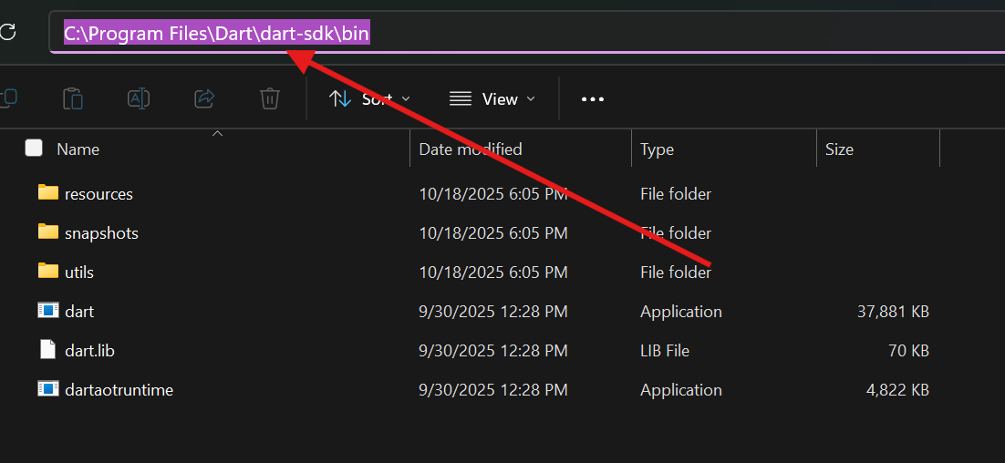
INSTALLATION DART TO VSC
Select the Dart SDK path and copy this path

Slide 20
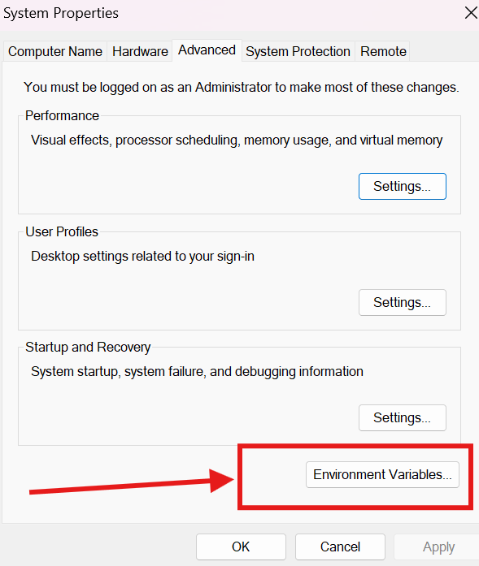
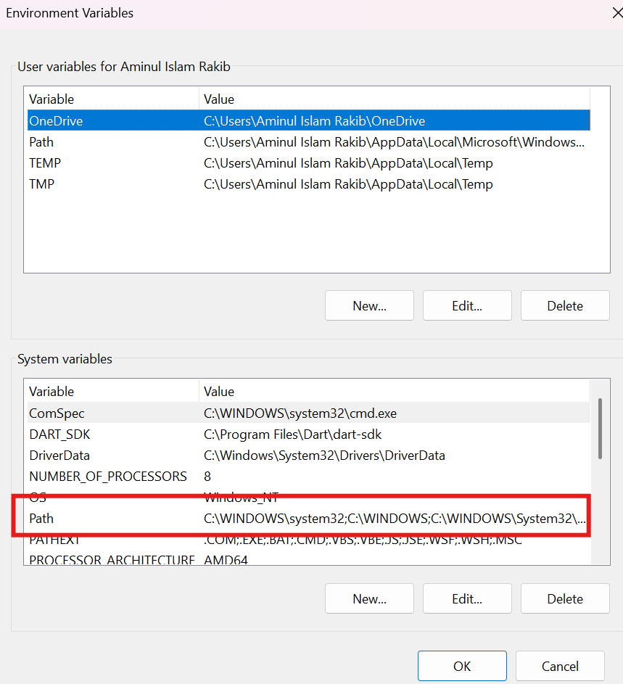
INSTALLATION DART TO VSC
Click Environment variables, then double click the Path

Slide 21
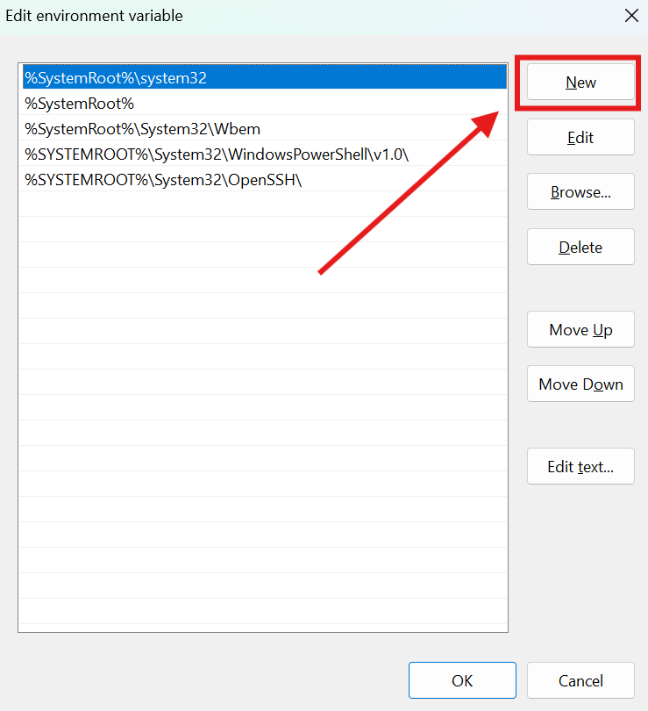
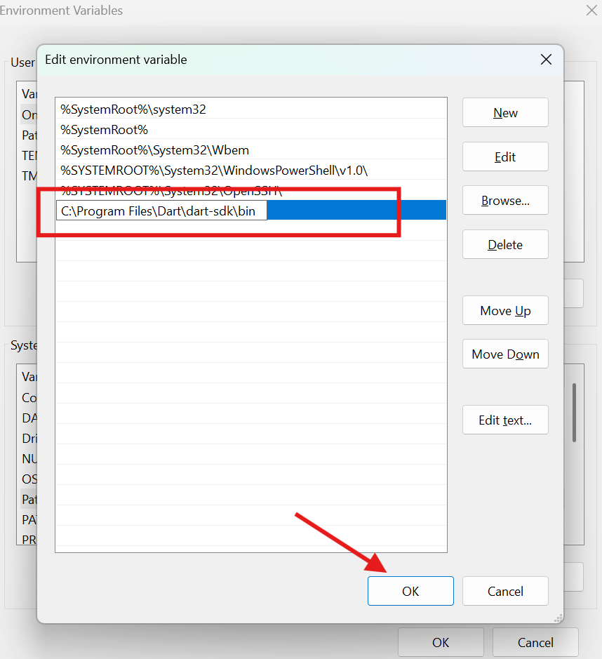
INSTALLATION DART TO VSC
Click New, paste the copied path, then click OK and close all boxes with OK

Slide 22
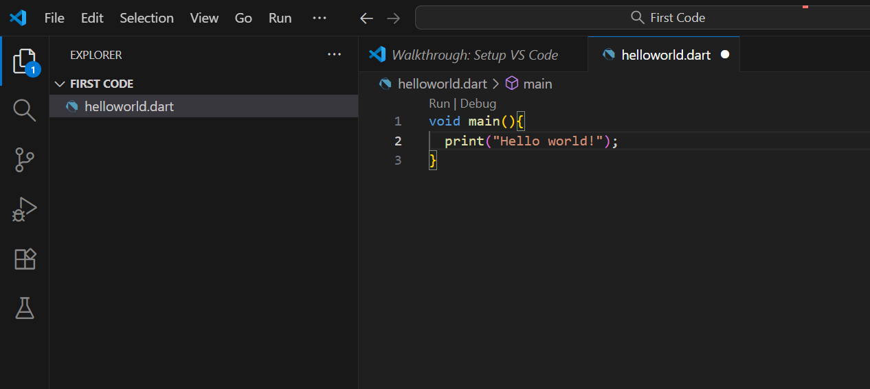
RUN VS CODE
Run the first code

Slide 23
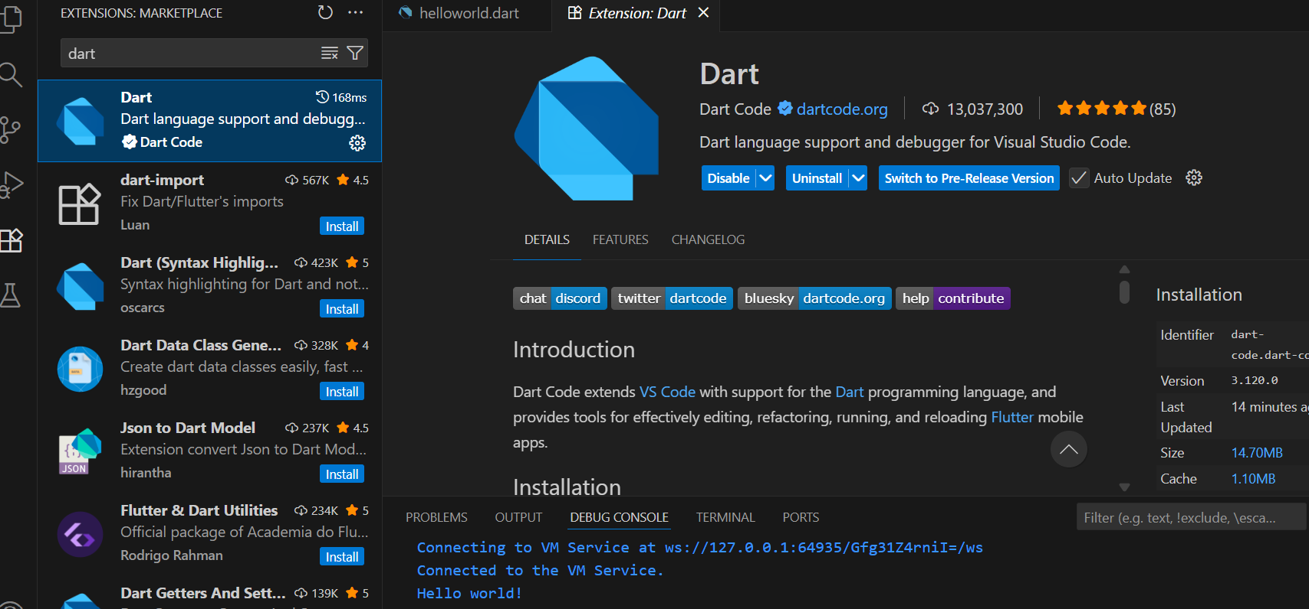
RUN VS CODE
Install the Dart extension

Slide 24
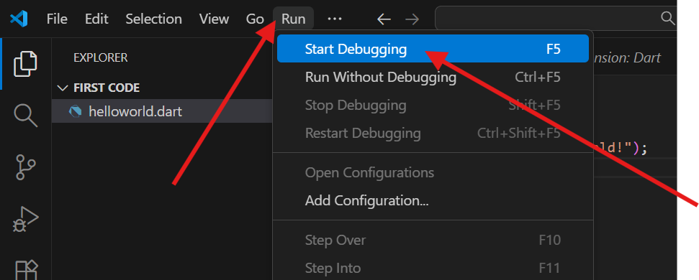
RUN VS CODE
Click the Run and Start Debugging option

Slide 25
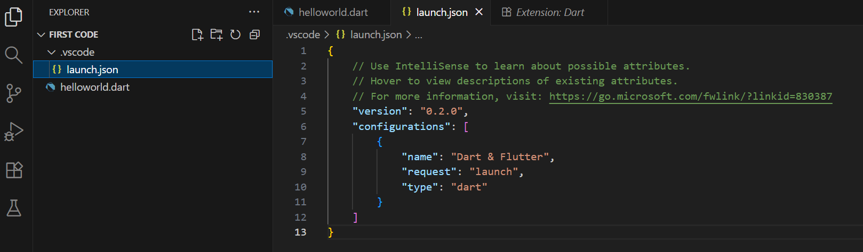
RUN VS CODE
VS Code automatically creates the launch.json file

Slide 26
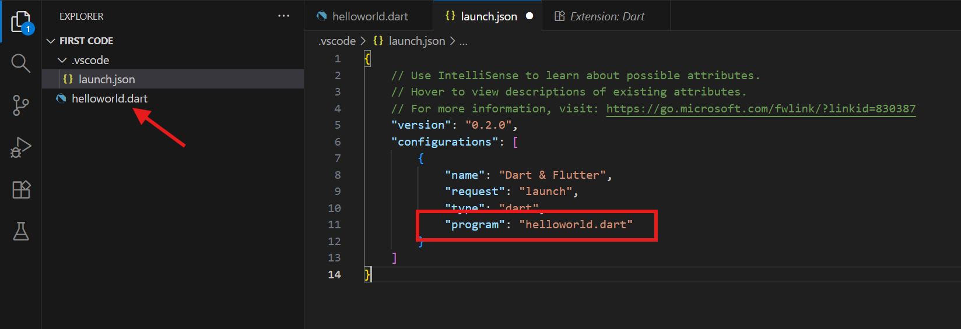
RUN VS CODE
Add the program and our file name, then save this file

Slide 27
RUN VS CODE
Click Run and Start Debugging again

Slide 28



GITHUB & CI/CD PART 1
What is Git?
What is GitHub?
Git is a version control system that tracks changes in source code and helps developers work together on software projects.
GitHub is an online platform used to store and collaborate on Git repositories.
Why Version Control Matters
Git
= Version Control
Tracks changes in source code
Keeps previous versions of the project
Helps team members collaborate
Reduces the risk of losing code
Makes it easier to identify and fix mistakes
GitHub
= Online Repository & Collaboration

Slide 29
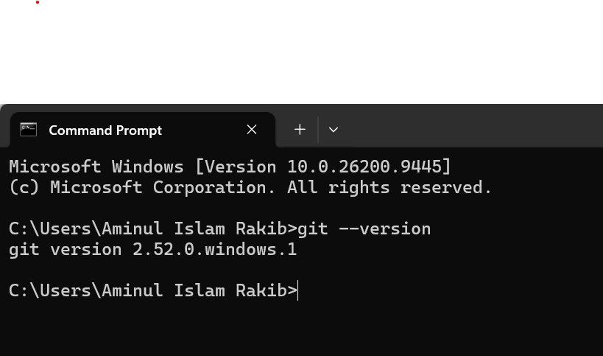
INSTALL & CONFIGURE GIT
1
Go to the Git official website: https://git-scm.com/install/windows
2
Download the file based on your operating system, like Windows or macOS
3
Install Git
4
Now we need to check the Git version
5
Open Command Prompt and write:
git --version

Slide 30
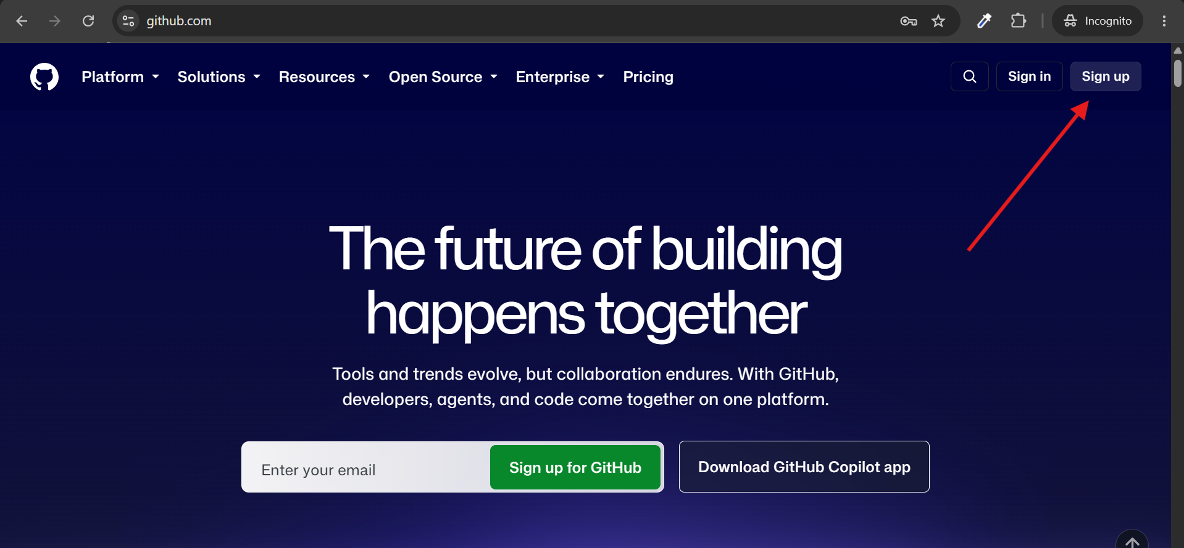
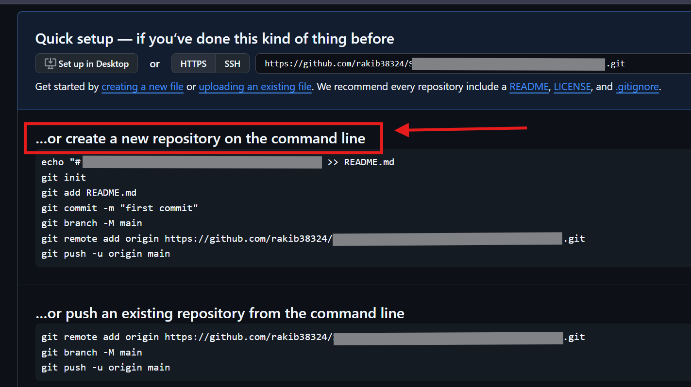
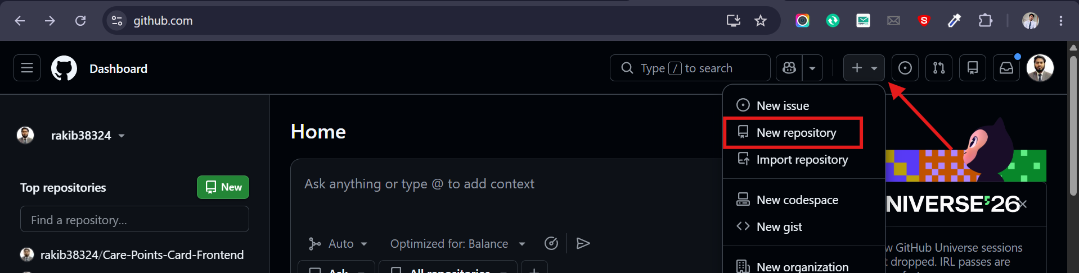
PUSH MY CODE INTO GITHUB
1
Create your GitHub account
2
Create a repository
3
Follow the instructions
For better understanding, watch: Click Video Tutorial

Slide 31
BASIC GIT WORKFLOW
Clone a project to your computer from GitHub:
Better commit messages:
1
git clone <repository-url>
Add student information program
Fix input validation
Update README with setup instructions
2
Check changes:
git status
3
Stage changes:
git add .
README.md:
4
Commit changes:
Project name and description
Installation/setup instructions
How to run the project
git commit -m "Add student information program"
5
Get the latest changes:
git pull
.gitignore
6
Upload your changes:
git push
.dart_tool/
build/
.pub/

Slide 32
ANY QUESTIONS?

Slide 33
THANK YOU
TMA3084 · Software Engineering Laboratory

